Slide 1
Introduction to Computer Software

Slide 2
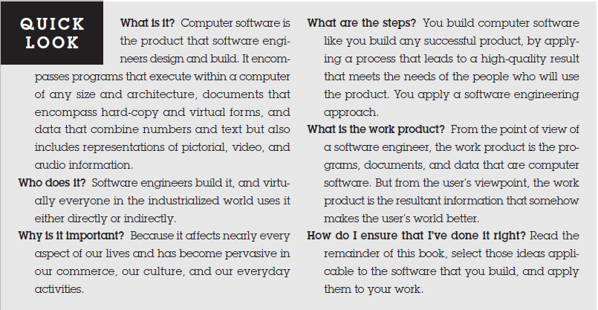

Slide 3
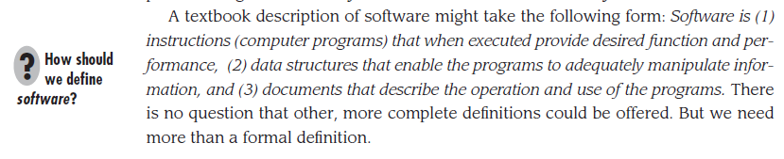

Slide 4
Software Characteristics

Slide 5
1. Software is developed or engineered, it is not manufactured in the classical sense.

Slide 6
Cont..
The phrase emphasizes that software development is distinct from traditional manufacturing. While manufacturing involves creating physical products through standardized processes and raw materials, software development is intangible, creative, and involves writing code and algorithms to create functional computer programs. Software development is iterative, flexible, and easily distributable digitally, making it fundamentally different from classical manufacturing processes.

Slide 7
2. Software doesn't "wear out."
The "bathtub curve" for hardware failure rates, shows that hardware experiences high failure rates early due to design or manufacturing defects, followed by a steady-state period of low failure rates. However, over time, hardware can wear out and experience rising failure rates again due to environmental factors.
In contrast, software is not susceptible to the same environmental factors and is expected to follow an "idealized curve," initially experiencing high failure rates due to undiscovered defects, which then decrease as the defects are corrected. However, as software undergoes changes and maintenance, new defects can be introduced, causing spikes in the failure rate curve. Over time, the minimum failure rate rises, showing that software deteriorates due to change. The "actual curve" for software reflects this deterioration as changes are made and new defects emerge, causing the failure rate to increase gradually.

Slide 8
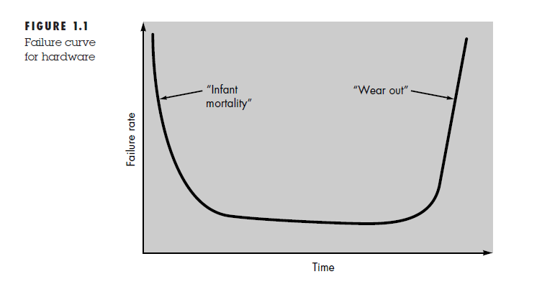
Bath Tub Curve for hardware

Slide 9
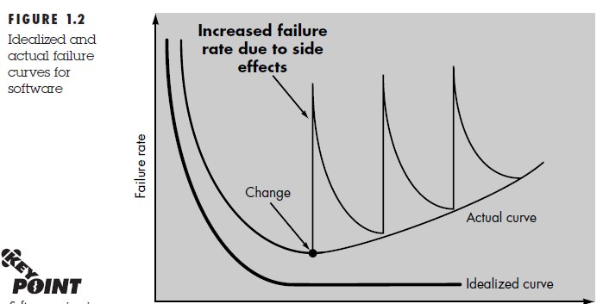
Idealized and Actual Curve for Software

Slide 10
3. Although the industry is moving toward component-based assembly, most software continues to be custom built.

Slide 11
Cont..
It describes concept of component reuse in engineering, highlighting the differences between hardware and software engineering. In hardware engineering, engineers use standard components like integrated circuits with well-defined functions and interfaces, allowing them to focus on innovative aspects of the design.
In contrast, software engineering has only recently embraced component reuse. Software components should be designed to be reusable in multiple programs, encompassing both algorithms and data structures. Modern software engineering utilizes reusable components for graphical user interfaces, enabling easier creation of graphics windows, menus, and interaction mechanisms.

Slide 12
Cont..
The passage underscores the importance of component reuse in software development, as it facilitates efficiency and innovation by allowing engineers to build new applications from pre-existing building blocks.

Slide 13
Introduction to Process and Software Process

Slide 14
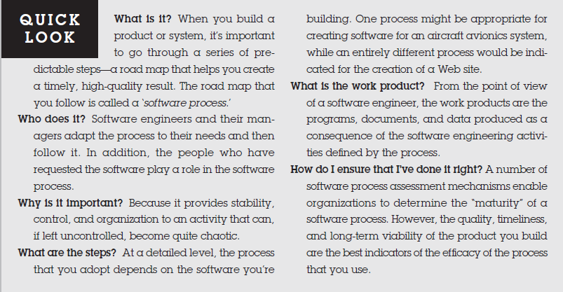

Slide 15
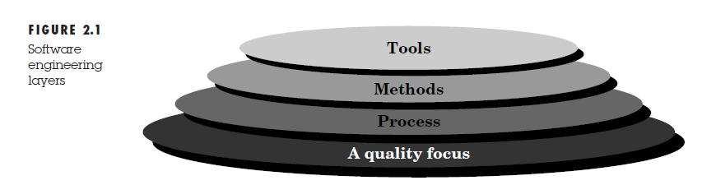
SOFTWARE ENGINEERING: A LAYERED TECHNOLOGY

Slide 16
Process, Methods, and Tools
The foundation of software engineering is the process layer, which ensures effective and timely development of computer software. It includes key process areas (KPAs) that govern project management, technical methods, work product production, milestones, quality, and change management.
Software engineering methods provide technical guidelines for tasks like analysis, design, programming, testing, and support, guided by basic principles and modeling activities.
Software engineering tools automate and support the process and methods. When integrated, they form a computer-aided software engineering (CASE) system, akin to hardware CAD/CAE, enhancing software development efficiency and productivity.

Slide 17
Five generic process framework activities?
A process framework establishes the foundation for a complete software engineering process by identifying a small number of framework activities that are applicable to all software projects, regardless of their size or complexity. In addition, the process framework encompasses a set of umbrella activities that are applicable across the entire software process. A generic process framework for software engineering encompasses five activities:

Slide 18
Communication
Communication. Before any technical work can commence, it is critically important to communicate and collaborate with the customer (and other stakeholders11 The intent is to understand stakeholders’ objectives for the project and to gather requirements that help define software features and functions.

Slide 19
Planning
Planning. Any complicated journey can be simplified if a map exists. A software project is a complicated journey, and the planning activity creates a “map” that helps guide the team as it makes the journey. The map—called a software project plan—defines the software engineering work by describing the technical tasks to be conducted, the risks that are likely, the resources that will be required, the work products to be produced, and a work schedule.

Slide 20
Modeling
Modeling. Whether you’re a landscaper, a bridge builder, an aeronautical engineer, a carpenter, or an architect, you work with models every day. You create a “sketch” of the thing so that you’ll understand the big picture—what it will look like architecturally, how the constituent parts fit together, and many other characteristics. If required, you refine the sketch into greater and greater detail in an effort to better understand the problem and how you’re going to solve it. A software engineer does the same thing by creating models to better understand software requirements and the design that will achieve those requirements.

Slide 21
Construction and Deployment
Construction. This activity combines code generation (either manual or automated) and the testing that is required to uncover errors in the code.
Deployment. The software (as a complete entity or as a partially completed increment) is delivered to the customer who evaluates the delivered product and provides feedback based on the evaluation.

